Slide 1
Writing playsets for Fiascomatic

Slide 2
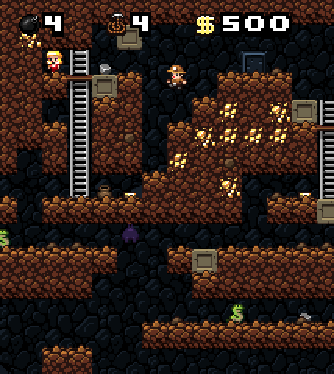
Procedural content generation
In the games world,
Content means all the stuff that isn’t the game code
Dialog
Models, sprites, animations, textures
Music
Levels
Procedural means making something using an algorithm
So PCG means using code to make content
Rather than having it human-authored
Sort of a really complicated random number generator
Spelunky

Slide 3
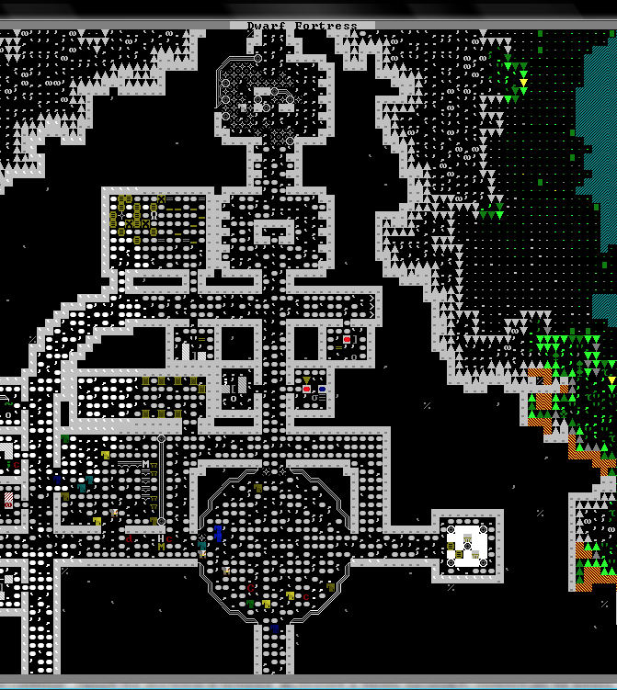
Why PCG?
Cost
Making games is enormously labor intensive
Make the computer do the scut work
Let the humans focus on creative work
Customization
Adapt content to player
E.g. dynamic difficulty adjustment
Replayability
Game is different every time you play it
Game can go on forever
Roguelikes
Dwarf Fortress

Slide 4

Assignment 3
Work in groups of 3
Make a PCG system for Fiasco
Choose a theme
Make a “playset”
Write it as Prolog code
Algorithmic work is already done
Don’t need to write any recursions of list iterations
You just need to do knowledge engineering

Slide 5
Setup phase
Work together to choose
Relationships between characters
One for each pair of characters sitting next to one another
Needs of characters
Locations the action will take place in
Objects (props) that appear in the world
“Playsets” for different genres
Touring rock band
Boogie Nights-style disco
Western
Bank robbery
They define the possible relationships, needs, locations, and objects

Slide 6
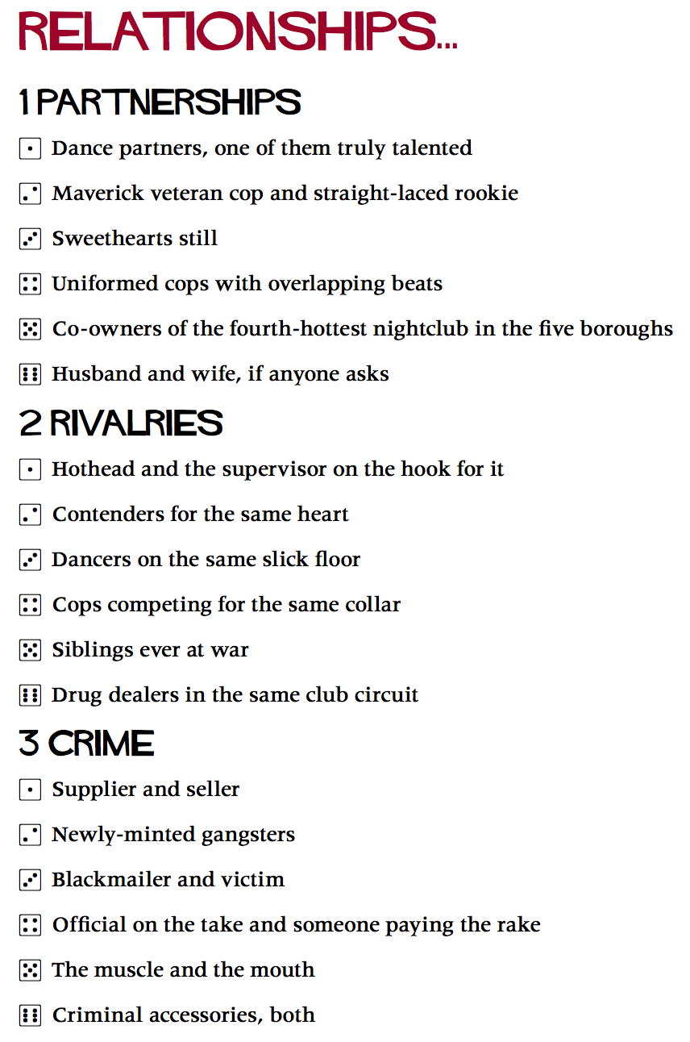
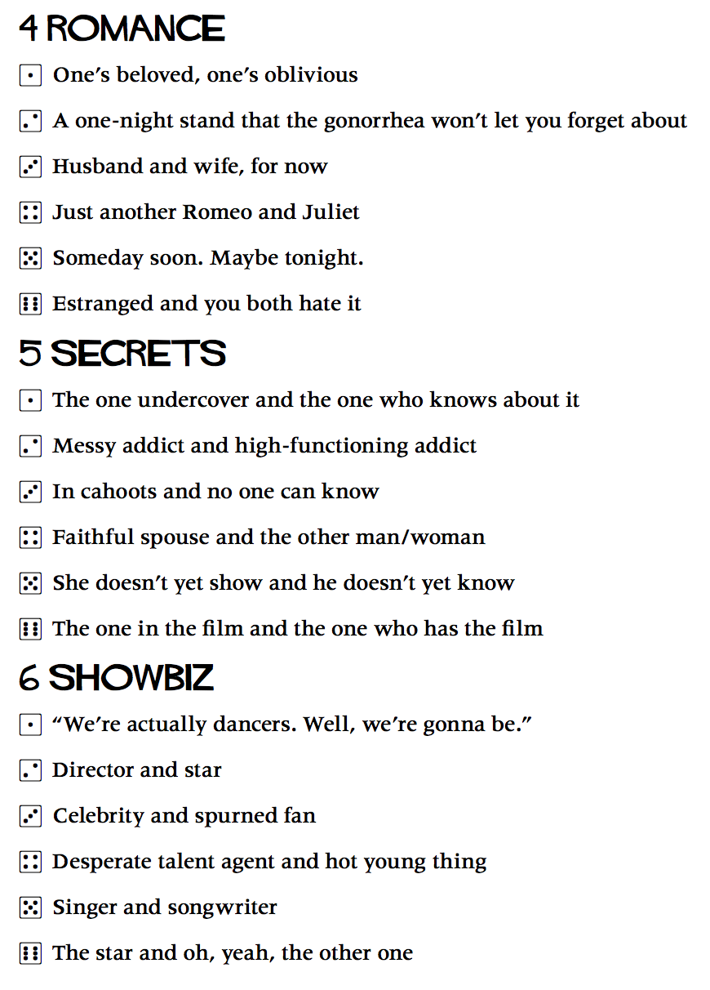
A playset: Saturday Night ’78 by Wil Wheaton and Jason Morningstar
http://www.bullypulpitgames.com/wiki/index.php?title=Saturday_Night_%2778

Slide 7
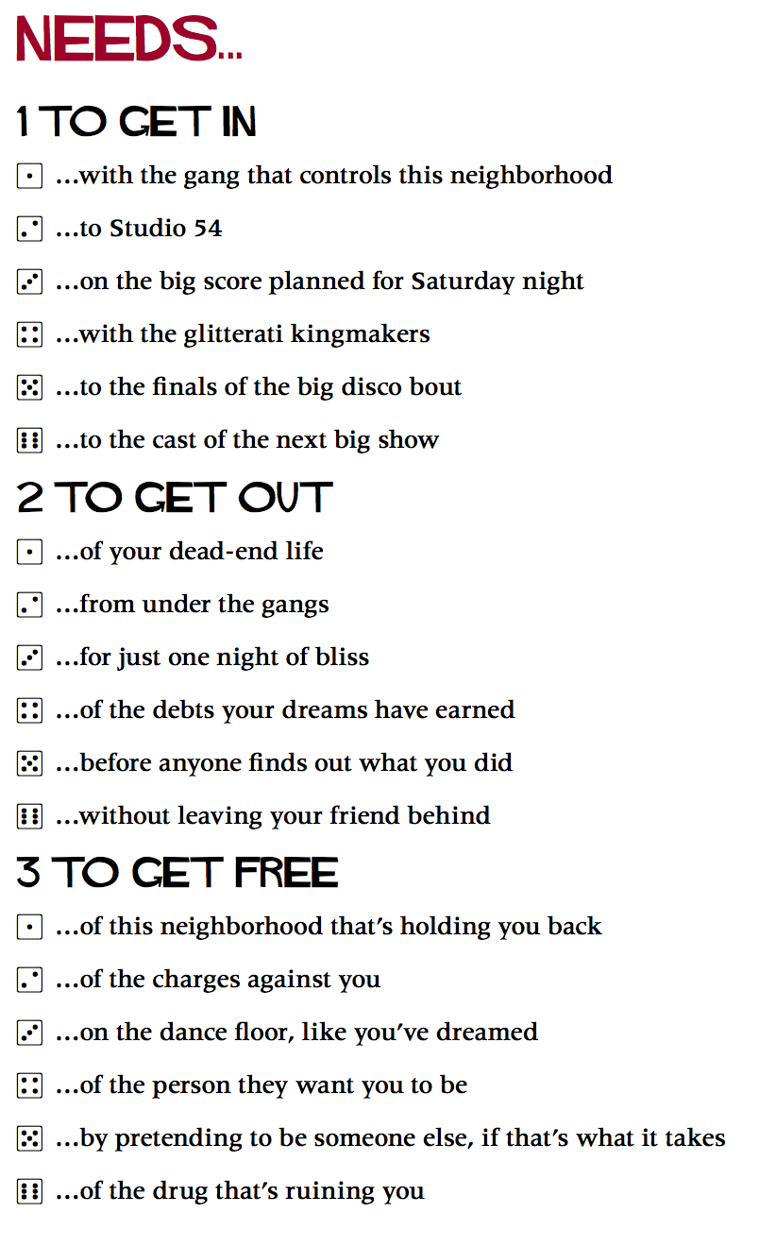
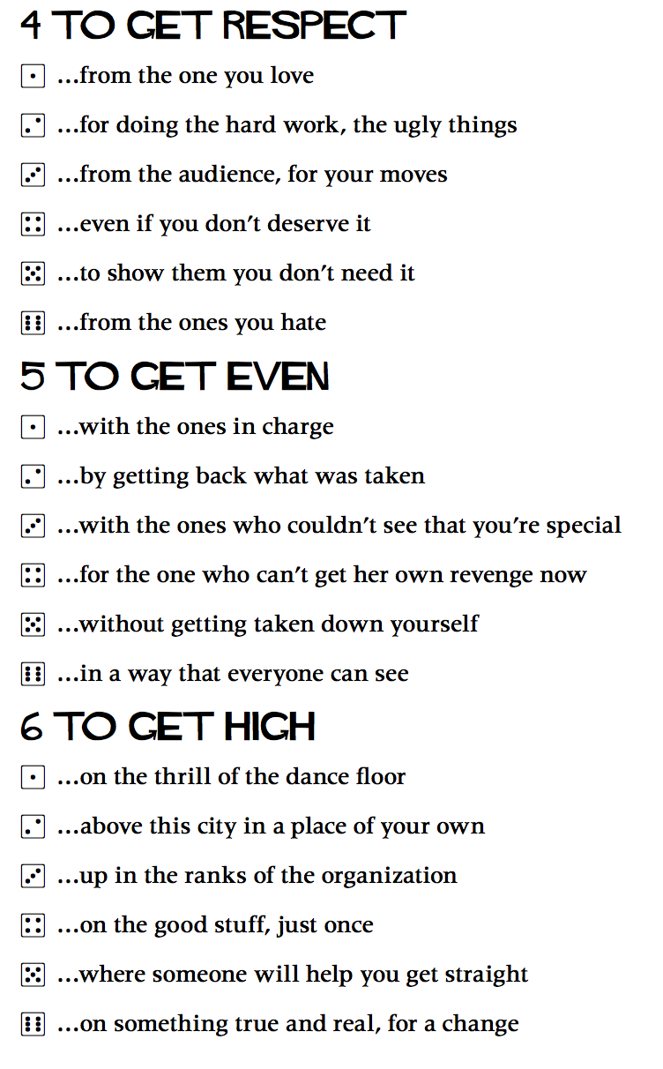
A playset

Slide 8
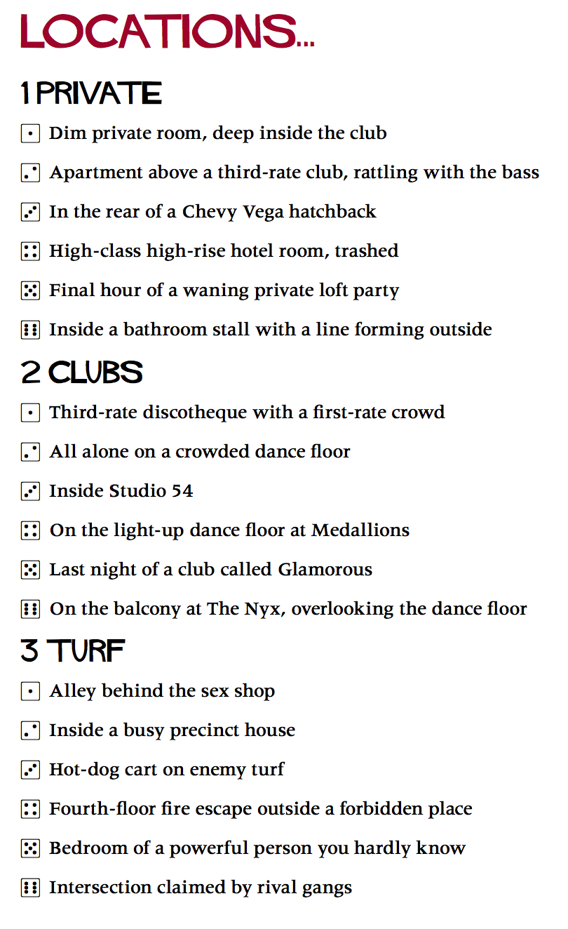
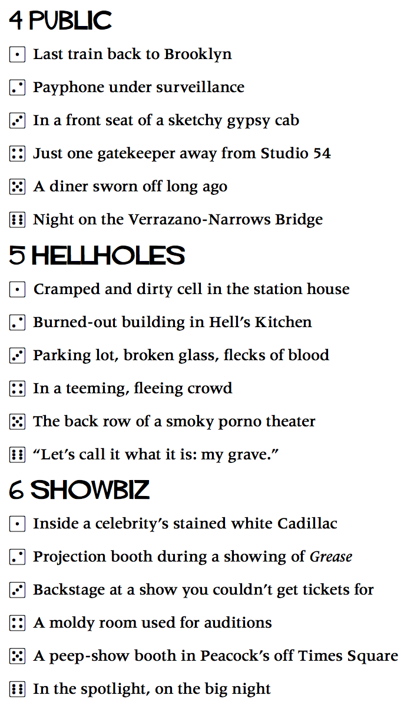
A playset

Slide 9
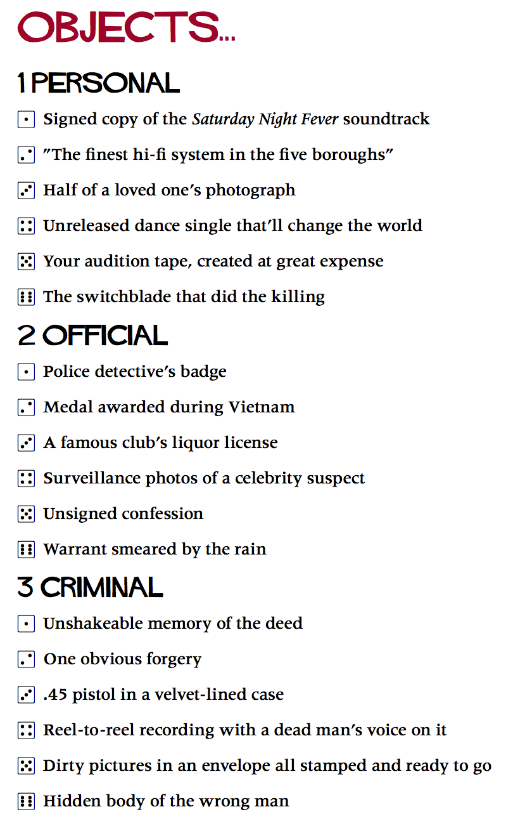
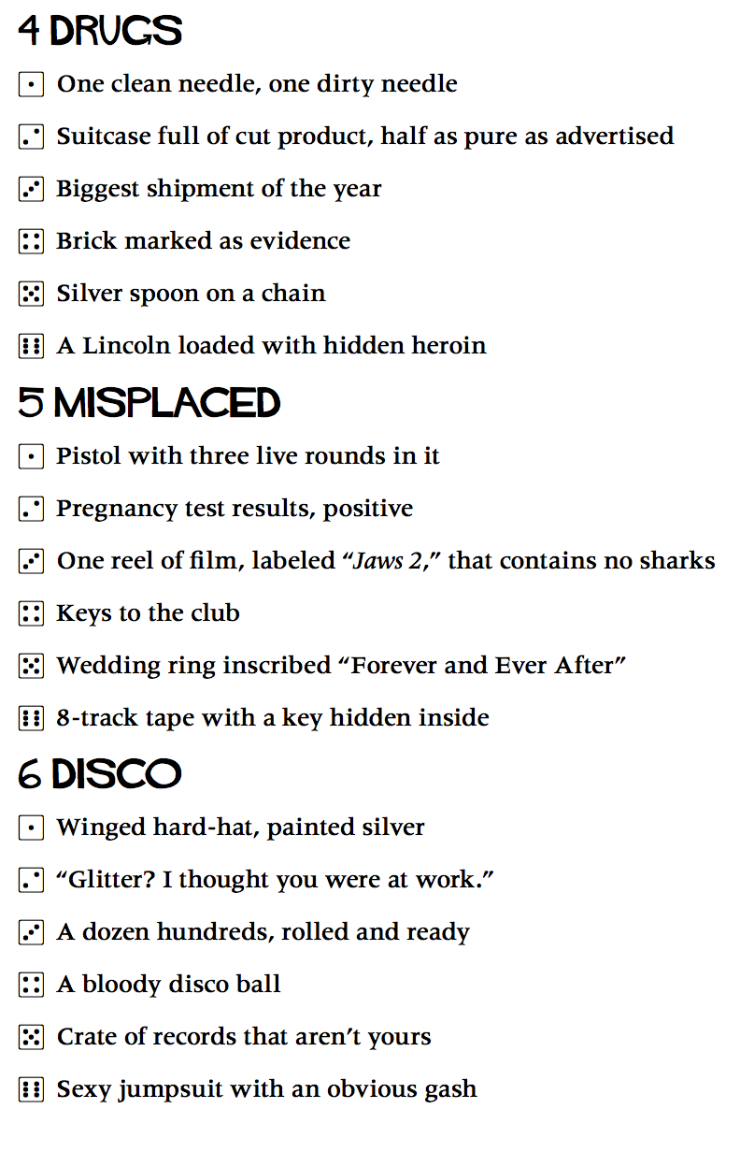
A playset

Slide 10
Why I never get to play Fiasco
It takes too long!
Setup usually takes 2 hours
Then your supposed to play 2 acts
With 2 scenes for each character in each act
Each scene usually takes at least 10 minutes
Then you do a closing montage
So even with only 3 players, you’re looking at 4-5 hours

Slide 11
Technology to the rescue
I’ve written a Fiasco setup generator
You’re going to write playsets for it
And next Friday, we’ll play them in class
Or rather however much we can manage in an hour

Slide 12
Generating a setup
Start from a playset
Defines possible relationships, locations, etc.
Randomly choose appropriate relationships, etc.
So it’s kind of like MADLIBs
Problem: some combinations are contradictory
Doesn’t make sense for a character to be both a cop and a reporter
Or for A to be B’s parent and B also to be A’s parent
So we need to filter our selections to avoid contradictions

Slide 13
Basic idea
A setup is a collection of facts
Try different combinations of them until you find one that’s consistent
Don’t want contradictory facts
A superhero who’s trying to cause the apocalypse
Unless you’re going for a dark Watchman-style story
A villain who rescues puppies
Unless you’re going for comedy
Unfortunately, this isn’t how Prolog works
It wants you to give it facts
And it will make inferences from them

Slide 14
Writing a Prolog program
Given a playset specifying
Possible facts about relationships, needs, locations, and objects.
Implications of different facts
Other facts they imply
What possible facts contradict one another
It computes random setups
Keeps a list of facts in the setup
Chooses a new fact to add
Computes a list of all its implications
So it’s forward-chaining
Checks them against the list of existing facts
Backtracks if it finds a contradiction
Adds them to the list if not

Slide 15
What a setup looks like
A setup is bunch of facts of the form
relationship(Character1, Relationship, Character2)
relationship(fred, siblings, charlotte)
relationship(charlotte, parent_of, fred)
relationship(charlotte, boss-employee, fred)
needs(Character, Need)
needs(charlotte, fifty_grand_by_tuesday)
has(Character, Object)
has(fred, a_dog_with_a_lisp)
at(Character, Location)
at(fred, elvis_presley_impersonator_convention)

Slide 16
What a playset looks like
A playset is bunch of facts and rules in Prolog that define
Possible relationships, needs, locations, and objects
relation(parent_of).
relation(siblings).
location(elvis_presley_impersonator_convention).
Implications of the above
Examples:
implies(relationship(X, sibling, Y), relationship(X, family, Y)).
What facts are contradictory
contradiction(relationship(X, parent_of, Y), relationship(Y, parent_of, X)).

Slide 17
Defining relations, needs, objects, and locations
Add facts like these to your prolog file
relation(RelationName)
RelationName is a possible relationship between characters
Example: relation(parent_of).
Allows facts like relationship(sally, parent_of, betsy)
need(NeedName)
Says NeedName is a possible need for characters
So need(money) allows facts like needs(sally, money)
object(ObjectName)
Says ObjectName is a possible prop to add to the game
location(LocationName)
Say LocationName is a possible location to add to the game

Slide 18
Defining implications and contradictions
implies(Fact1, Fact2)
Says that Fact1 is true in a setup, then Fact2 must be too
contradiction(Fact1, Fact2)
Says Fact1 and Fact2 can’t be true in the same setup
Most of the facts look like one of these
relationship(C1, R, C2)
role(C, Role)
needs(C, Need)
at(C, Location)
has(C, Object)
But you can add new kinds of facts if you want
profession(C, Job)
gender(C, Gender)

Slide 19
Example: defining a symmetric relation
Some relationships are symmetric (i.e. bidirectional)
We can teach that to the system by adding an implies rule
relation(sibling).
implies(relationship(X, sibling, Y), relationship(Y, sibling, X)).

Slide 20
Example: defining a symmetric relation
Actually, this is a common enough case, that we just added a general rule for it
If you say symmetric(sibling)
Rather than just relation(sibling)
It will do the inference automatically
relation(R) :- symmetric (R).
implies(relationship(X, R, Y), relationship(Y, R, X)) :-
symmetric (R).
symmetric(sibling).

Slide 21
Higher-order properties of relations
symmetric(R)
If relationship(X,R,Y)
Then relationship(Y, R, X)
antisymmetric(R)
If relationship(X,R,Y)
Then not relationship(Y, R, X)
antireflexive(R)
relationship(X,R,X) is always false
transitive(R)
If relationship(X,R,Y)
and relationship(Y, R, Z)
Then relationship(X,R,Z)
You can declare any of these in your playset

Slide 22
Example: family
We may also want to represent that if people are siblings, they’re also family
Again, we can do that with an implies rule
symmetric(family).
implies(relationship(X, sibling, Y), relationship(X, family, Y)).

Slide 23
Generalization
But, this is also a common enough issue that we have a general rule for it
Just say: generalizes(SpecificRel, GeneralRel)
implies(relationship(X, R1, Y), relationship(X, R2, Y)) :-
generalizes(R1, R2).
generalizes(sibling, family).

Slide 24
Assigning roles
Relationships often assign roles to the characters
Boss/roadie
Tour manager/dude under managers thumb
Boss/weird guy with tool bag
If we assign one of the relationships, we want to remember the roles of the individual characters
implies(relationship(X, boss/roadie, _), role(X, boss)).
implies(relationship(_, boss/roadie, Y), role(Y, roadie)).

Slide 25
Role relations
Again, it’s useful to make this a general feature
Just declare: roles_relation(boss/roadie)
Instead of just relation(boss/roadie)
And it will infer the roles automagically
relation(R1/R2) :- role_relation(R1/R2).
relation(R1/R2) :- role_relation(R2/R1).
implies(relationship(X, R1/_, _), role(X, R1)).
implies(relationship(_, _/R2, Y), role(Y, R2)).
roles_relation(boss/roadie).

Slide 26
Contradictory roles
Characters might end up with multiple roles
Sister of one character
Boss of another
But some combinations are nonsensical
Husband and Pope
Astronaut and toddler
Employer and puppy
Conflicting_roles lets you disallow particular combinations
contradiction(role(C, R1), role(C, R2)) :-
conflicting_roles(R1, R2).
conflicting_roles(husband, pope).
conflicting_roles([husband, pope]).

Slide 27
Example: a Washington politics playset
Simple playset involving
Politicians and their minions (staffers, strategies)
Donors who want things (lobbyists and billionaires)

Slide 28
Relationships
roles_relation(politician/lobbyist).
roles_relation(politician/staffer).
roles_relation(politician/strategist).
roles_relation(politician/billionaire).
roles_relation(politician/journalist).
roles_relation(politician/estranged_child).

Slide 29
Role conflicts
conflicting_roles([politician, lobbyist, strategist, journalist, billionaire, staffer).

Slide 30
You can only have one boss
contradiction(relationship(X, strategist/politician, Y), relationship(X, strategist/politician, Z)) :- Y \= Z.
contradiction(relationship(X, staffer/politician, Y), relationship(X, staffer/politician, Z)) :- Y \= Z.
Or:
right_unique(staffer/politician).
right_unique(strategist/politician).

Slide 31
Very important subtlety
There are two different kinds of things we’ve been calling “facts”
Assertions in Prolog’s database
Information about the current setup: who has what relationship with who, who has what objects, etc.
These are not in Prolog’s database, they’re in a list inside the solver’s algorithm
The solver only checks for contradictions
Between the setup facts
And only compares them two at a time
You can’t say “these things are a contradiction if some third thing is also in the setup”

Slide 32
Another important subtlety
There are two different kinds of things we’ve been calling “facts”
Assertions in Prolog’s database
Information about the current setup: who has what relationship with who, who has what objects, etc.
These are not in Prolog’s database, they’re in a list inside the solver’s algorithm
The solver can’t handle setup facts that have variables in them
Those introduce a world of hurt, so it doesn’t try to handle them
Facts must be ground literals (no variables)

Slide 33
Other relationships
symmetric(old_flames).
symmetric(political_rivals).
implies(relationship(X, political_rivals, _), role(X, politician)).
implies(relationship(_, political_rivals, X), role(X, politician)).

Slide 34
Needs
need(hide_my_addiction_to(X)) :-
drug(X).
drug(meth).
drug(crack).
drug(bath_salts).
drug(human_blood).
need(kleptomaniac).
need(streaking).

Slide 35
Some needs have restrictions
need(make_my_parent_suffer).
implies(needs(C, make_my_parent_suffer), role(C, estranged_child)).
need(retire_with_a_cushy_wall_street_job).
implies(needs(C, retire_with_a_cushy_wall_street_job), role(C, politician)).
need(get_the_big_scoop).
implies(needs(C, get_the_big_scoop), role(C, journalist)).
need(make_50_grand_before_tuesday).
contradiction(needs(C, make_50_grand_before_tuesday), role(C, billionaire)).

Slide 36
Locations
location(the_capitol_building).
location(a_corn_farm_in_iowa).
location(a_fact_finding_tour_in_the_bahmamas). implies(at(C, a_fact_finding_tour_in_the_bahamas), role(C, politician)).
location(the_oval_office).
location(a_dc_pickup_bar).
location(the_watergate_hotel).
location(the_david_letterman_set).
location(the_police_station).

Slide 37
Objects
object(ronald_reagans_ouija_board).
object(an_experimental_truth_serum).
object(half_a_kilogram_of_heroin).
object(the_nuclear_football).

